Slide 1



E-Waste Generation Classification
EfficientNetV2B0

Slide 2

Learning Objectives
To understand and apply Transfer Learning using the EfficientNetV2B0 model for e-waste image classification.
To explore data preprocessing and augmentation techniques to enhance model generalization and performance.
To train, validate, and test a deep learning model using TensorFlow and evaluate its performance through various metrics including accuracy, confusion matrix, and classification report.
To develop the capability to visualize model training progress and interpret results through graphs and heatmaps.
To gain hands-on experience in deploying machine learning models using Gradio to create an interactive web interface for real-time image classification.
To contribute to environmental sustainability by providing a solution to automate e-waste sorting processes.
GOAL

Slide 3
Tools and Technology
Tools Used :
The project primarily utilized Python as the programming language due to its versatility and strong ecosystem of machine learning and data science libraries. For deep learning development, TensorFlow and its high-level interface Keras were used to build, train, and fine-tune the image classification model. These tools provided a scalable and flexible environment for leveraging pre-trained models and customizing them for the e-waste classification task.
To handle image preprocessing and manipulation, Pillow (PIL) was employed, enabling resizing, conversion, and preparation of images in formats compatible with the model. For model evaluation and generating detailed performance reports, Scikit-learn was used, offering essential tools such as confusion matrices, classification reports, and evaluation metrics like precision, recall, and F1-score.
Additionally, Matplotlib and Seaborn were chosen for visualizing data distributions, accuracy and loss curves, and confusion matrices. These visualization tools played a crucial role in interpreting the model’s learning behavior and presenting the results in a clear and insightful manner.
Finally, Gradio served as the key tool for deployment, allowing the creation of a simple and interactive web interface where users could upload images and receive real-time classification predictions from the trained model.

Slide 4
Technology Used :
The technological backbone of the project is built on Deep Learning and Transfer Learning principles. Specifically, the use of EfficientNetV2B0, a state-of-the-art pre-trained convolutional neural network, enabled high performance with reduced computational costs. This model, originally trained on the large-scale ImageNet dataset, was fine-tuned to adapt to the specific e-waste classification challenge.
The solution also incorporates data augmentation technologies to artificially expand the training dataset through random transformations such as flipping, rotation, and zooming. This technique helps prevent overfitting and ensures that the model generalizes better to new, unseen images.
For deployment, the project leveraged Web Application Technology through Gradio, which enabled the transformation of the trained machine learning model into a fully functional web-based application. This made the solution accessible to non-technical users without the need for specialized software installations or programming knowledge.
Overall, the combination of artificial intelligence, computer vision, and modern deployment technologies provided an end-to-end solution capable of automating the classification of e-waste images with speed, accuracy, and ease of use.

Slide 5
Methodology
Data Collection & Preparation :
Collected and organized e-waste images into Training, Validation,and Test datasets.
Applied image resizing (128x128 pixels) for uniform input shape.
Loaded images using image_dataset_from_directory in TensorFlow.
Data Augmentation :
Applied random flipping, rotation, and zooming to increase dataset variability.
Helped the model to generalize better on unseen images and avoid overfitting.
Model Development :
Utilized EfficientNetV2B0, a state-of-the-art pre-trained Convolutional Neural Network model known for its accuracy and efficiency.
Fine-tuned the base model by adding:
Global Average Pooling Layer
Dropout Layer (to reduce overfitting)
Dense Softmax Layer for multi-class classification.

Slide 6
Model Training :
Compiled the model using Adam optimizer and Sparse Categorical Cross-Entropy loss.
Integrated EarlyStopping to halt training when no improvement was observed in validation loss, thereby saving computational resources.
Model Evaluation :
Visualized training and validation accuracy and loss over epochs.
Evaluated the model using:
Accuracy score
Confusion Matrix Heatmap
Classification Report with precision, recall, and F1-score.
Deployment with Gradio :
Built an interactive web interface using Gradio, allowing users to : Upload images.
Receive predictions with class name and confidence score.
Ensured the system is user-friendly and accessible without coding knowledge.

Slide 7
Problem Statement
The rapid advancement of technology and the increasing demand for electronic devices have led to a significant rise in the generation of electronic waste, commonly known as e-waste. E-waste includes discarded electronic appliances such as computers, mobile phones, televisions, and other consumer electronics that have reached the end of their usable life. The improper handling and disposal of e-waste pose severe environmental and health hazards due to the presence of toxic substances like lead, mercury, and cadmium. This situation has created an urgent need for efficient and accurate e-waste management systems that can aid in proper recycling and disposal.
Currently, most e-waste sorting processes are performed manually in recycling facilities. This manual sorting is time-consuming, labor-intensive, error-prone, and inefficient, often resulting in misclassification of waste materials. Inconsistent sorting not only reduces the effectiveness of recycling efforts but also leads to increased environmental pollution and resource wastage. Moreover, manual sorting exposes workers to harmful substances, putting their health at significant risk.

Slide 8
There is a clear gap in the use of automated, intelligent systems for classifying e-waste based on images, which could significantly improve sorting accuracy and operational efficiency. To address this challenge, there is a need to develop an AI-driven image classification system capable of automatically identifying different categories of e-waste with high accuracy, speed, and scalability. Such a solution could enhance the overall recycling process, reduce human effort, and contribute to environmentally responsible waste management practices.
The Challenge : The management of electronic waste is becoming a pressing environmental concern due to the rapid increase in discarded electronic devices.
Existing Limitations :
Manual e-waste sorting is slow, inefficient, and error-prone.
Incorrect classification leads to environmental damage and inefficient recycling.
Research Problem : To design a scalable and accurate AI-based system capable of automating the classification of e-waste images into different categories to enhance recycling efficiency.

Slide 9
Proposed Solution
Deep Learning Solution :
Leverage EfficientNetV2B0, a powerful transfer learning model, trained on a custom e-waste image dataset.
Apply data augmentation for robust performance.
Implement early stopping for optimal training.
Deployment Solution :
Deploy the trained model using Gradio, making it accessible through a web interface where users can upload images and receive real-time predictions.
Environmental Impact :
Reduces manual labor dependency.
Improves sorting speed and accuracy.
Contributes towards sustainable waste management practices.

Slide 10
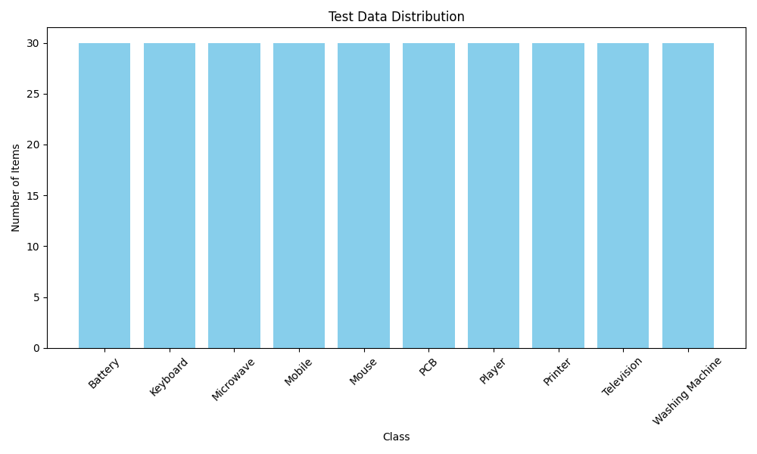
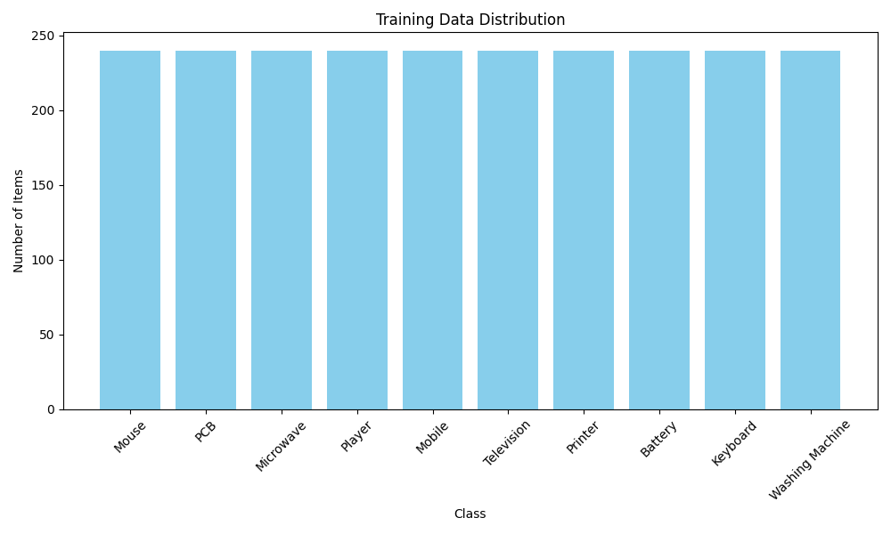
Screenshot of Output
Test Data Distribution :
Training Data Distribution :

Slide 11
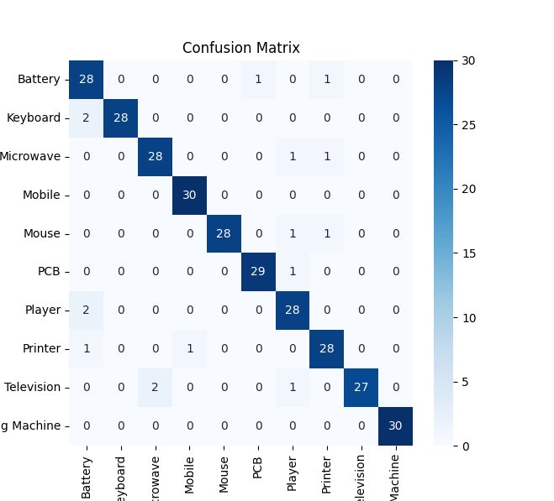
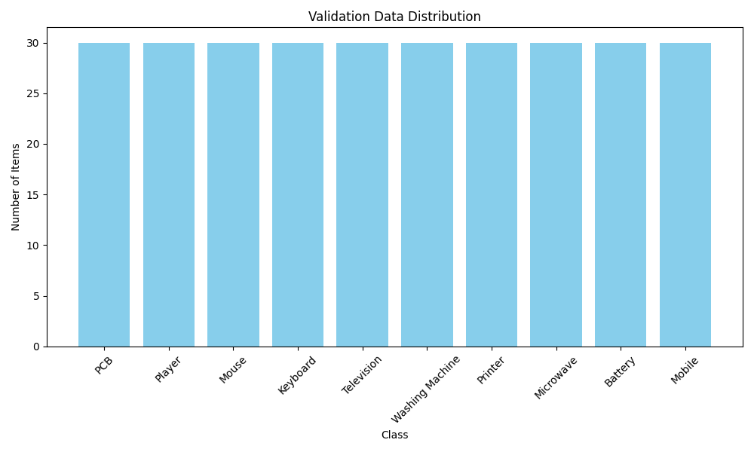
Validation Data Distribution :
Confusion Matrix :

Slide 12
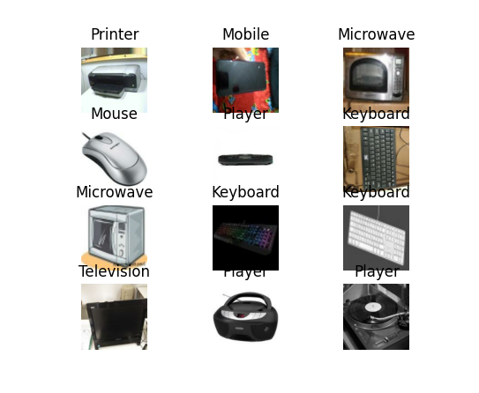
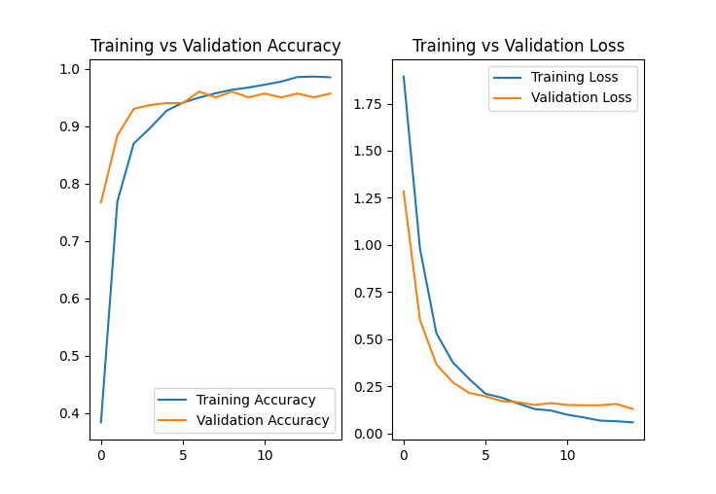
DataSet Training :
Training VS Validation :

Slide 13
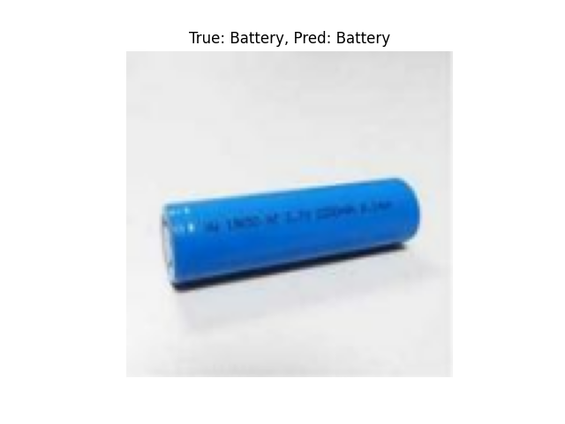
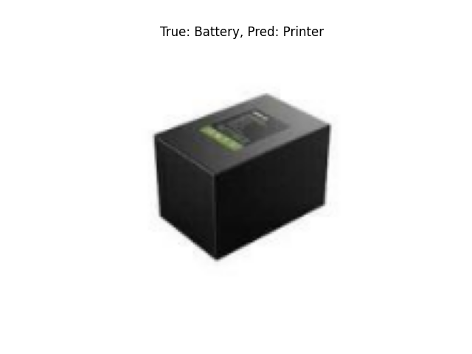
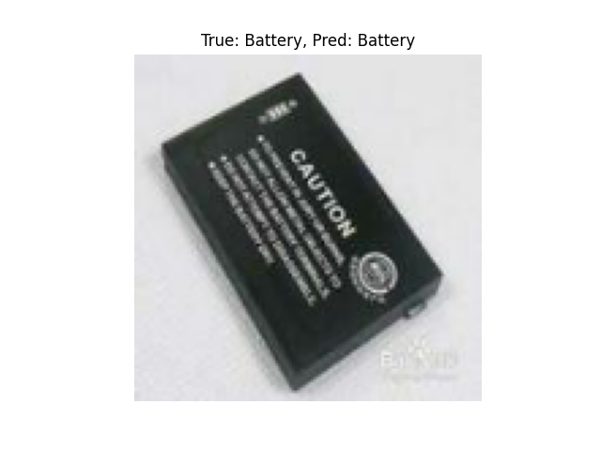
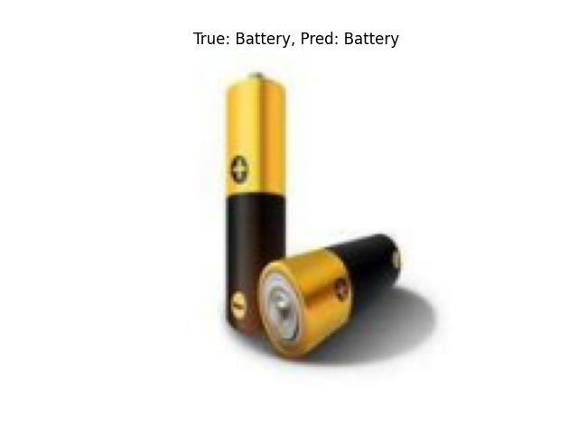
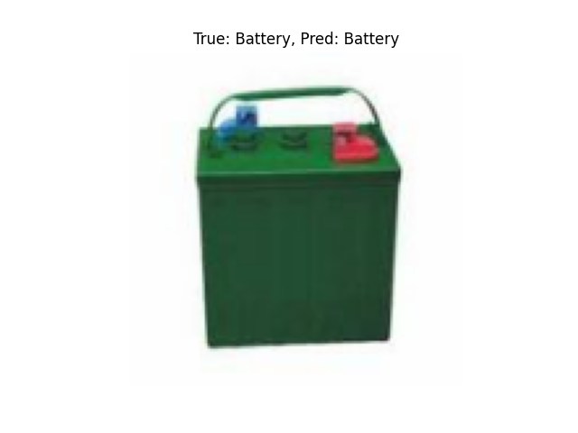
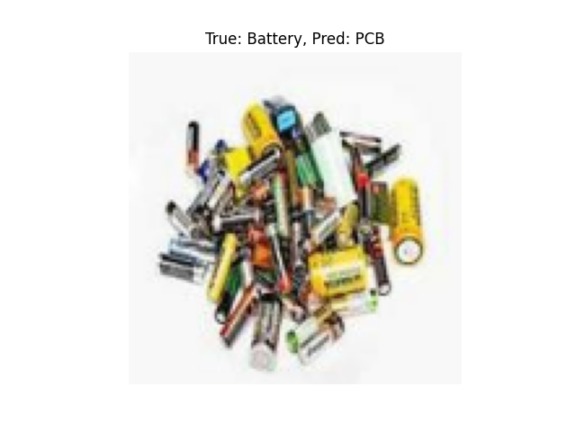
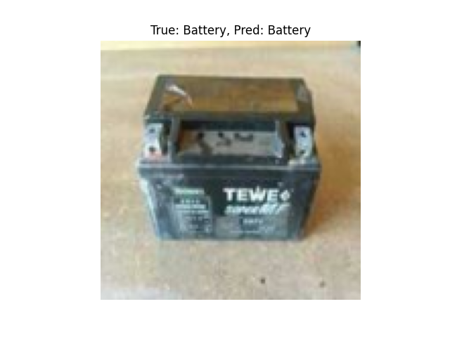
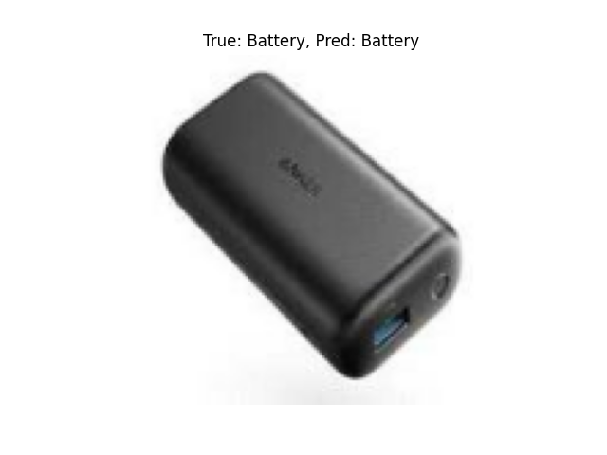
Predictions

Slide 14

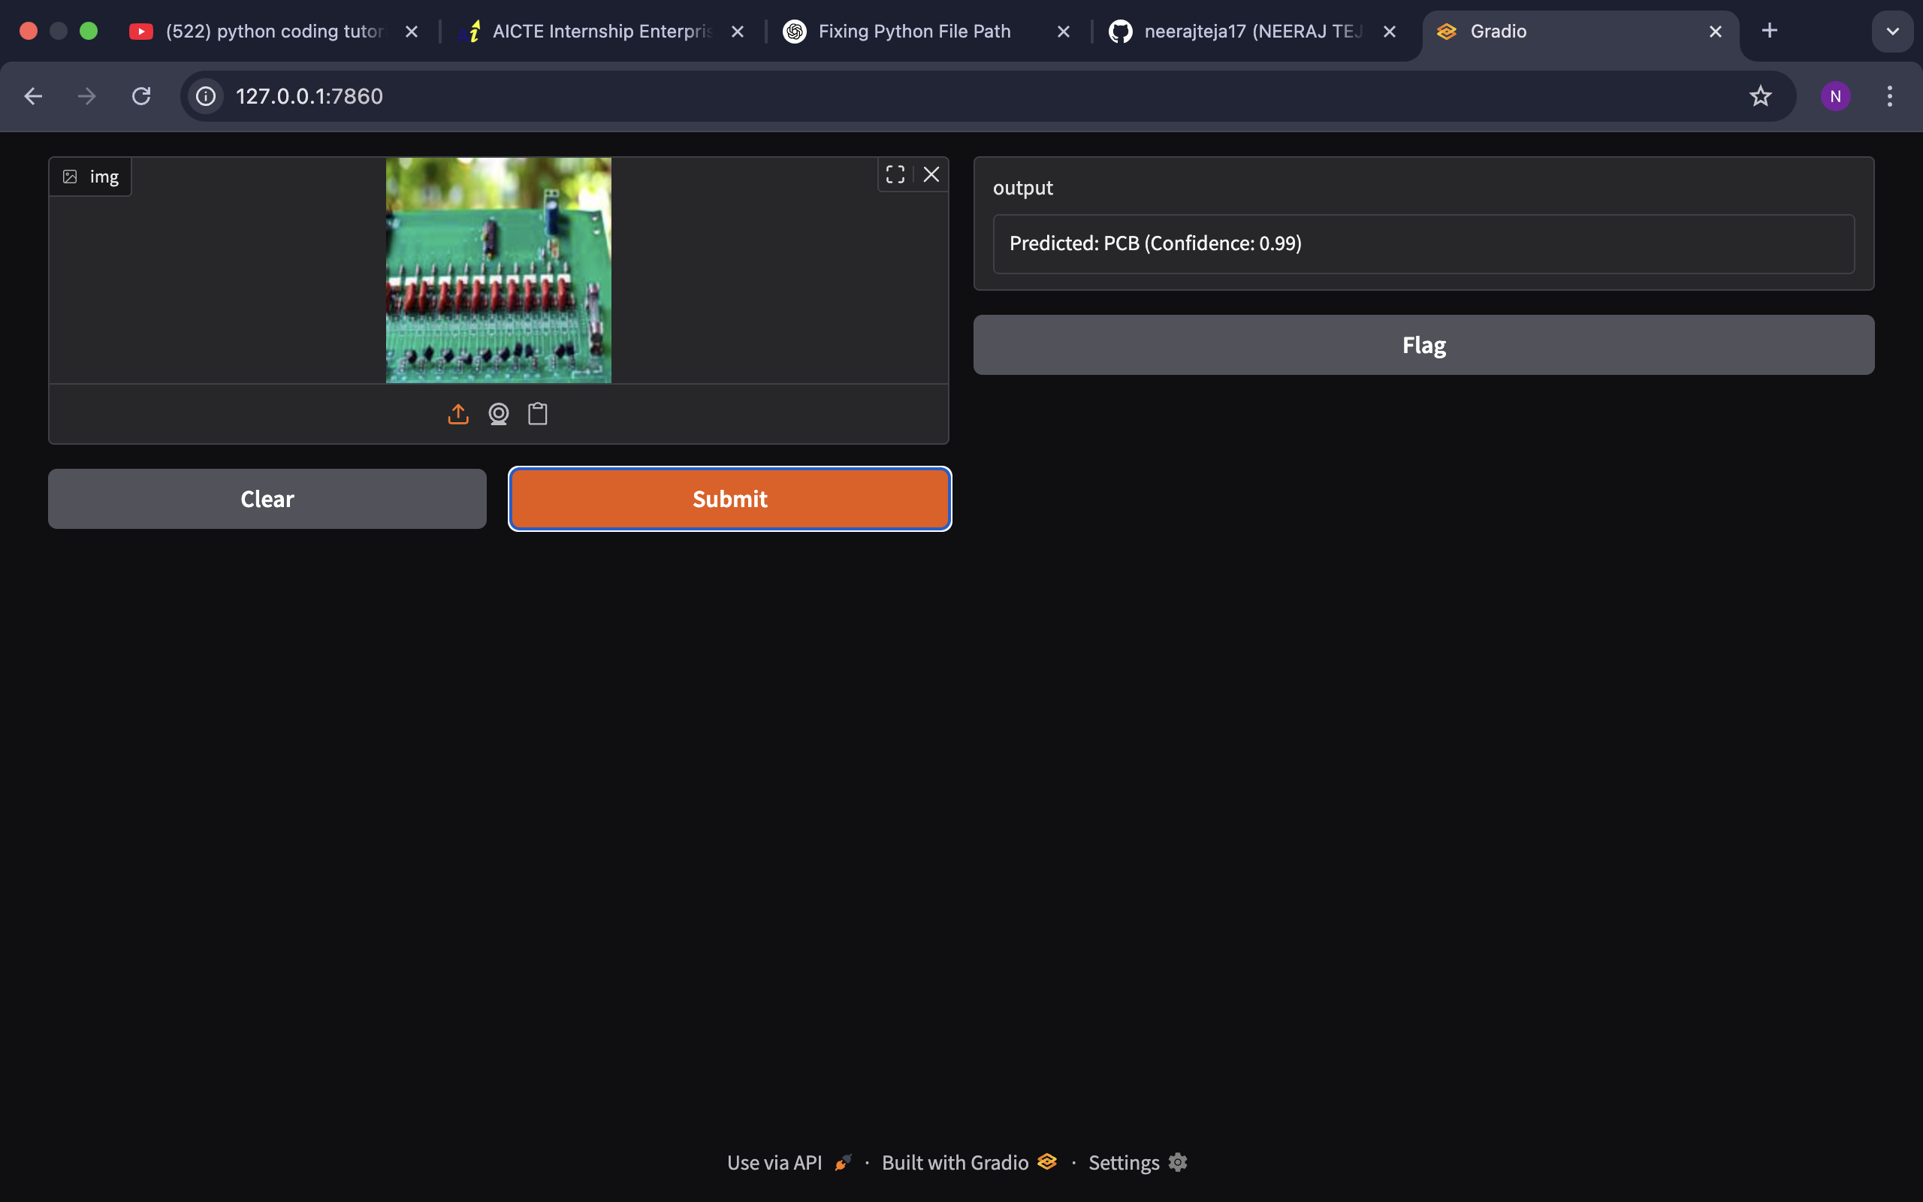
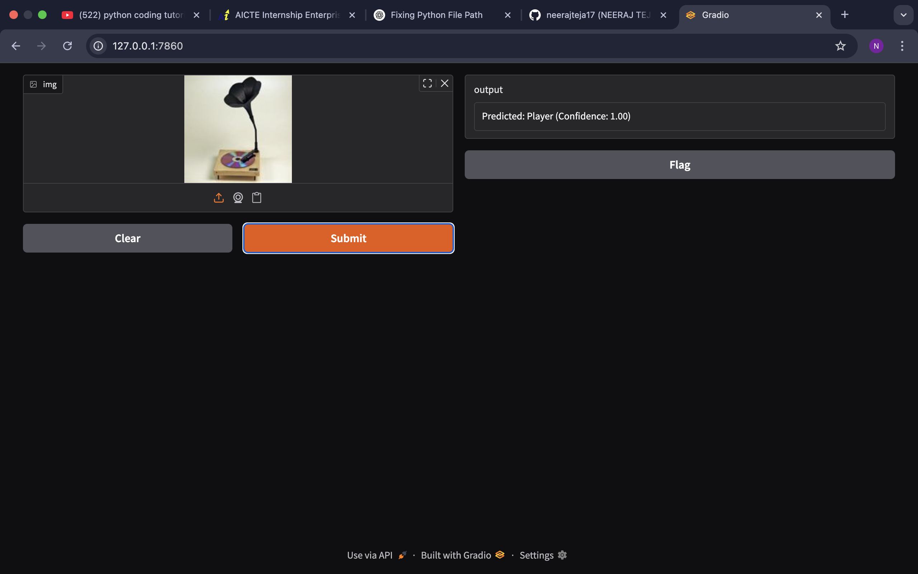
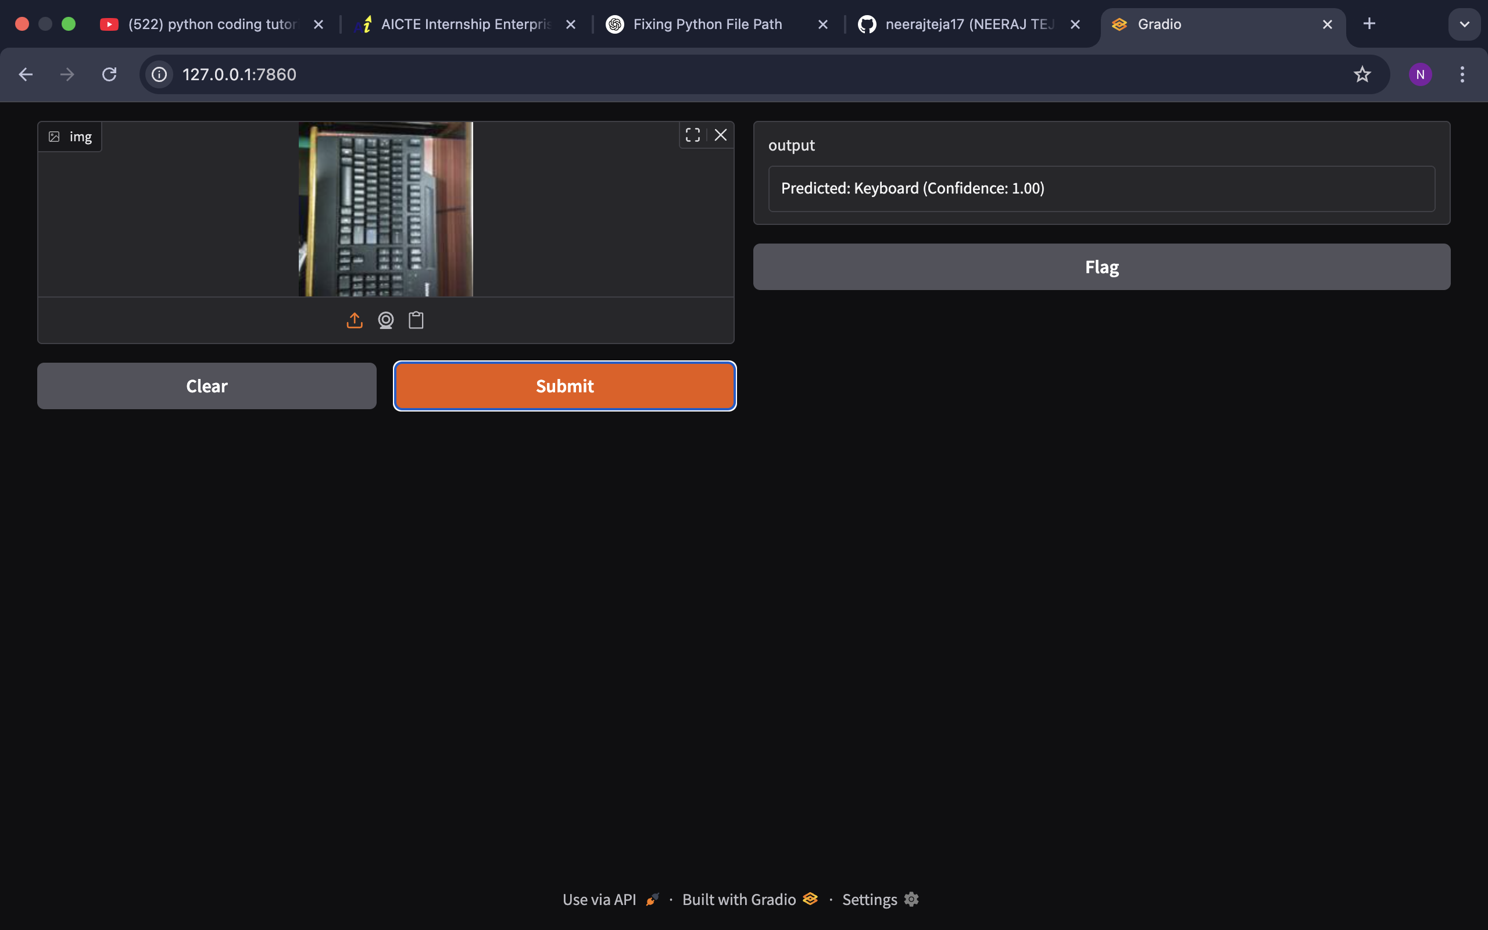
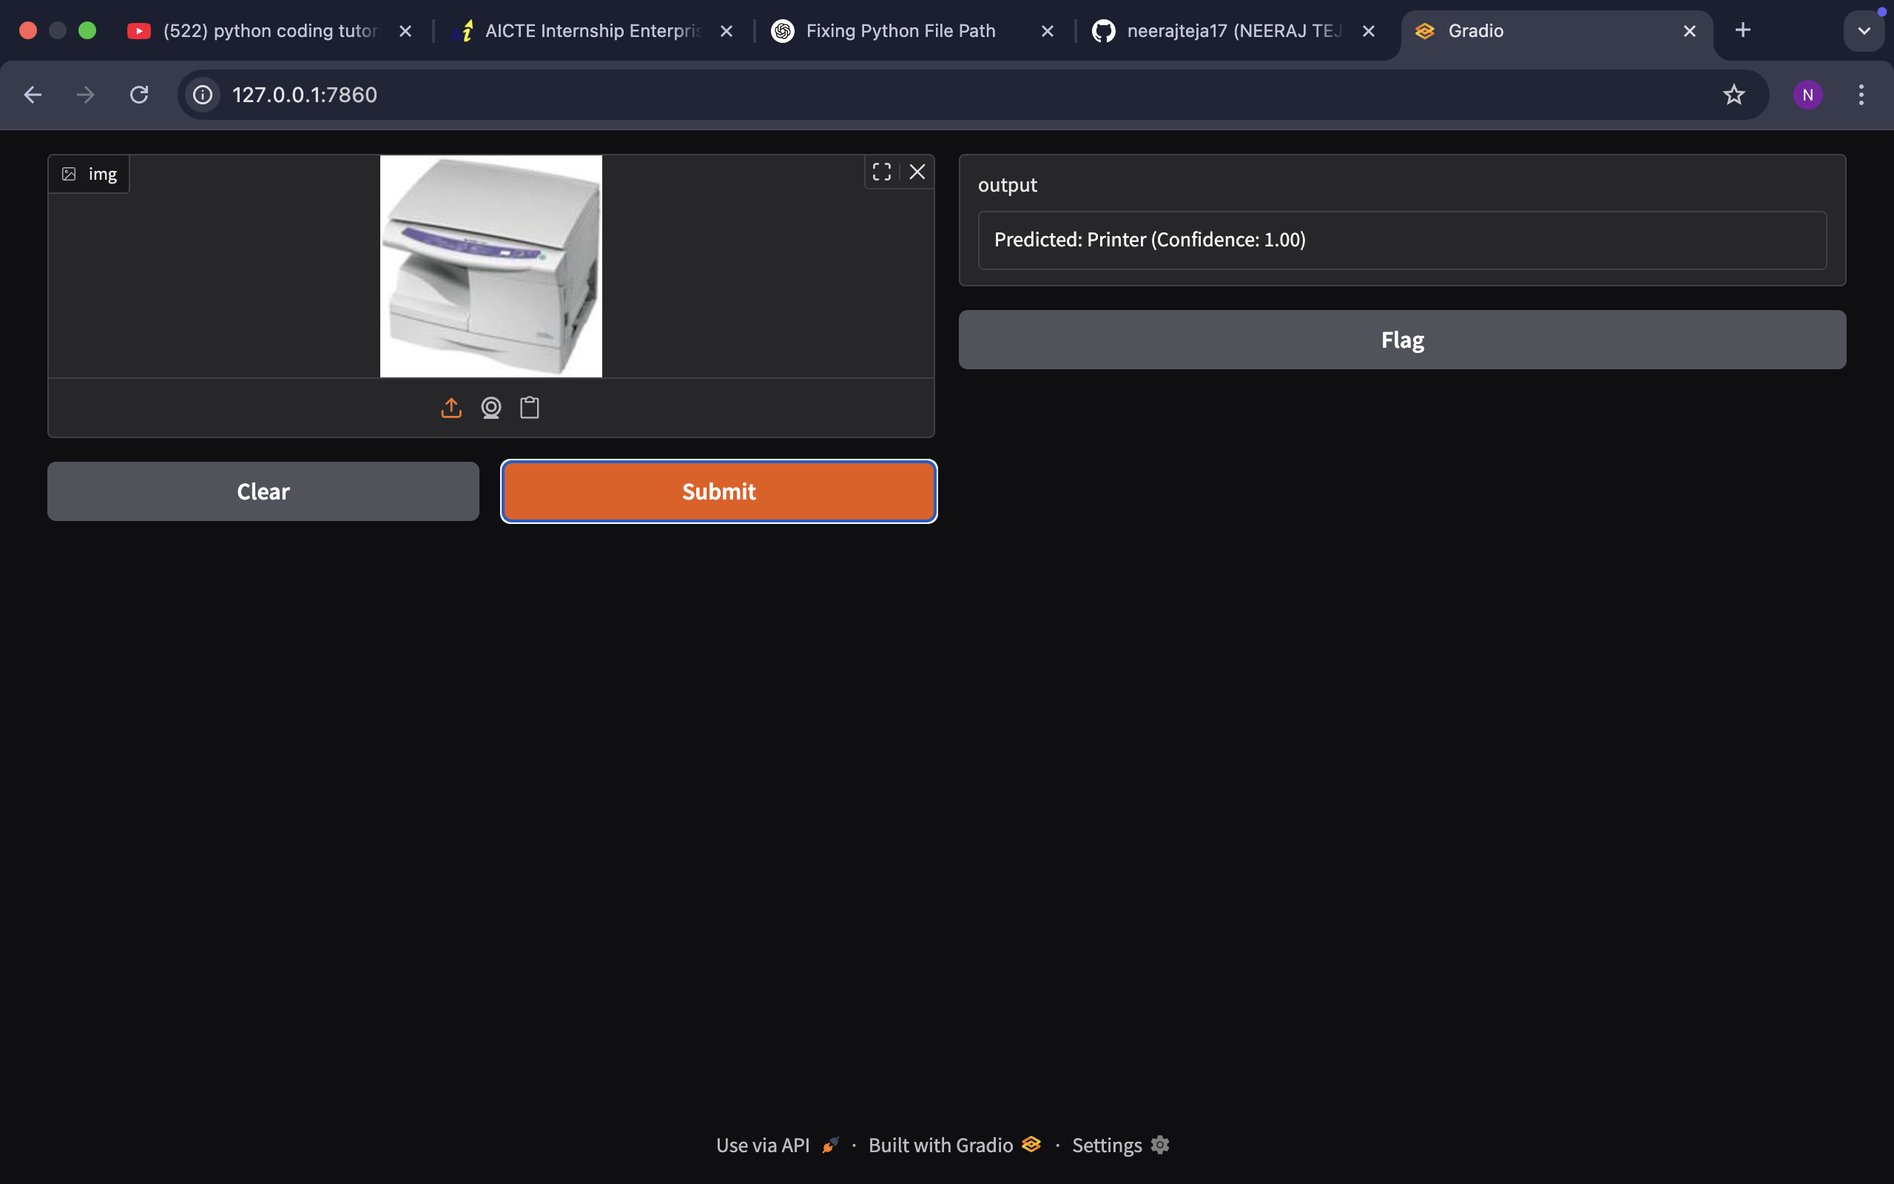
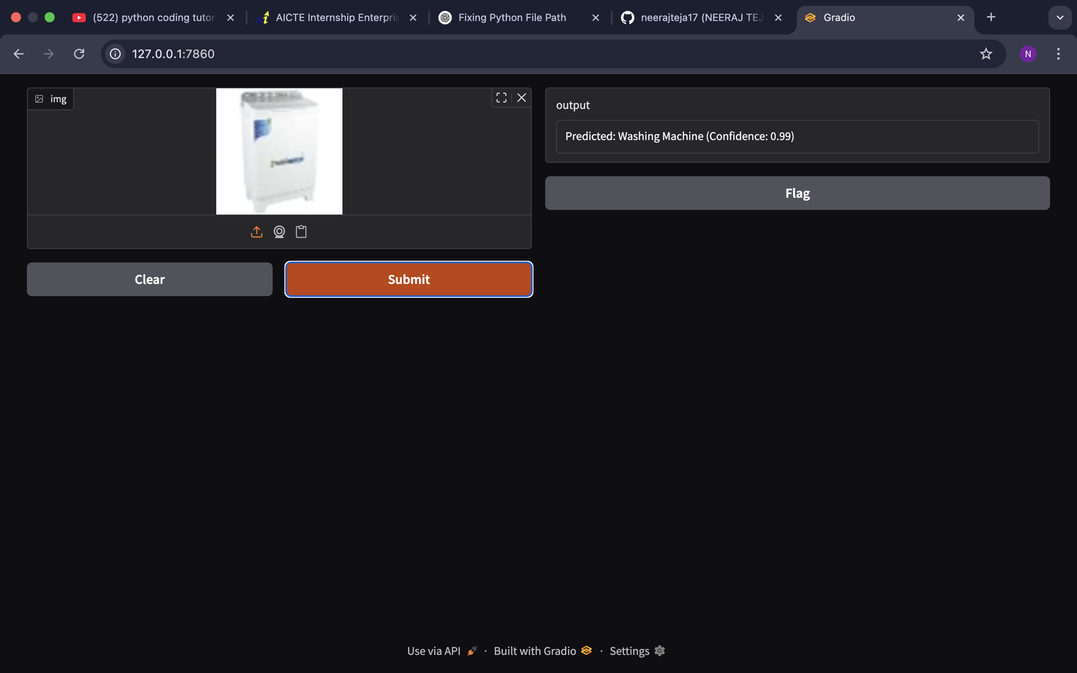
Gradio Web App

Slide 15
Conclusion
In this project, an AI-based e-waste image classification system was successfully developed using deep learning and transfer learning techniques. By leveraging the power of the EfficientNetV2B0 pre-trained model, the system was able to accurately classify images of e-waste into multiple categories, demonstrating the effectiveness of modern convolutional neural networks in solving real-world classification problems. The integration of data augmentation techniques contributed to improved generalization, while careful model evaluation using accuracy metrics, confusion matrices, and classification reports ensured robust performance analysis.
Furthermore, the deployment of the model through a Gradio-based web interface made the solution accessible and user-friendly, allowing for real-time image classification without the need for technical expertise. This end-to-end approach—from model development to deployment—offers a scalable and efficient solution that could significantly improve waste management processes, reduce manual sorting errors, and contribute to environmentally sustainable practices in e-waste recycling.

Slide 16
Future Work
While the developed system has demonstrated promising results, there are several opportunities for future enhancement and expansion. One key area for improvement is the collection of a larger and more diverse e-waste dataset, which would allow the model to learn from a broader range of samples and further improve classification accuracy. Additionally, incorporating real-time video-based detection or object detection models could extend the system's capabilities beyond static images, enabling automated sorting in dynamic recycling environments.
The deployment of the solution on mobile devices or embedded edge computing platforms, such as Raspberry Pi or NVIDIA Jetson, could facilitate on-site, real-time waste classification, making the system highly portable and practical for field use. Moreover, integrating this AI-based classification system with existing smart recycling infrastructure and Internet of Things (IoT) networks could enable fully automated waste processing pipelines, contributing to a more sustainable and efficient circular economy. Continued research into model optimization, interpretability, and environmental impact assessment will further strengthen the contribution of AI in addressing the global e-waste challenge.

Slide 17
GitHub Link
https://github.com/neerajteja17/E-WASTE-GENERATION-CLASSIFICATION-AICTE-SHELL-INTERNSHIP.git

